Slide 2
Unit Overview
This unit introduces students to the renowned places of interest in China. Reading A “World Cultural Heritage in China” is an introductory reading retrieved and adapted from online resources. It briefly describes a few iconic cultural and natural heritage sites in China. Reading B, “A Visit to Huangshan Mountain”, is a translated excerpt from Xu Xiake’s Travel, a famous book in Chinese history. Reading C consists of two passages, “ ‘Warriors’ Protect Hutong with Cameras” and “Problems of Hutong”, which present controversial points of view about the preservation and renovation of Hutong in Beijing.

Slide 3

Teaching
Objectives
1
Introduce famous places of interest in China
2
Provide detailed accounts of the cultural background of some places of interest
3
State their point of view about the preservation of cultural relics with supporting evidence

Slide 4
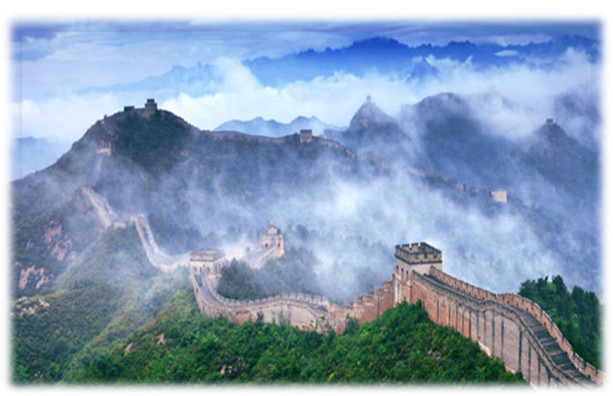
Contents
01
Lead-in:
UNESCO’s World Heritage List
02
Reading A:
World Cultural Heritage in China
03
Reading B:
A Visit to Huangshan Mountain
04
Reading C:
“Warriors” Protect Hutong with Cameras
& Problems of Hutong

Slide 5
上海外语教育出版社 出版
策 划：李冰诗
责任编辑：仝琳
校对测试：蒋雯璐
郑州大学外语学院 制作
主 编： 范春香 王伟
编 者： 李珩 寇平 郭华 丁萌 林青 段艳丹
©上海外语教育出版社，2017 版权所有 翻版必究

